Slide 1
Intro to Validation ECE 4740/5740 Professor Hanna

Slide 2
Validation
Resubstitution
Hold-out
K-fold cross-validation
LOOCV
Random subsampling
Bootstrapping

Slide 3
Resubstitution
All of the training data is used for training the AI model
Training data is input into the trained AI model to determine an error rate
Good for initially evaluating a model
Can the model predict it even when trained with it all?
But for validation….
Sketchy

Slide 4
Holdout
Data is split into two different datasets labeled as a training and a testing dataset
This can be a 60/40 or 70/30 or 80/20 split
Downside
Uneven distribution of different classes of data is found in training and test dataset
Stratification: create training and test dataset with equal distribution of different classes of data

Slide 5
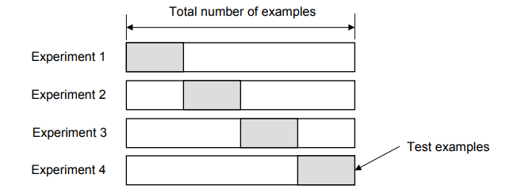
K-Fold Cross Validation
Advantage: entire data is used for training and testing
Error rate of the model is average of the error rate of each iteration.

Slide 6
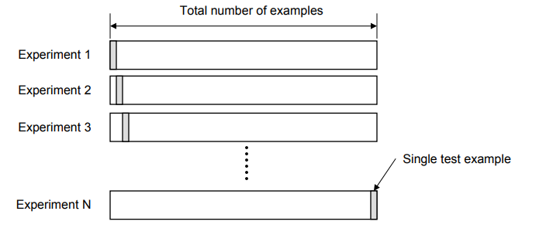
Leave-One-Out Cross-Validation (LOOCV)
All of the data except one record is used for training and one record is used for testing
Process repeated N times
Advantage: entire data is used for training and testing
Error rate of the model is average of the error rate of each iteration

Slide 7
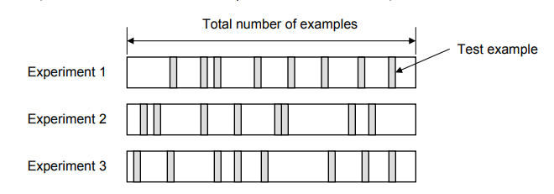
Random Subsampling
Multiple sets of data are randomly chosen from the dataset and combined to form a test dataset
Remaining data forms the training dataset
Error rate of the model is the average of the error rate of each iteration

Slide 8
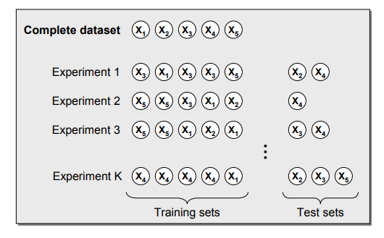
Bootstrapping
Training dataset is randomly selected with replacement
Remaining examples that were not selected for training are used for testing
Error rate of the model is average of the error rate of each iteration

Slide 9
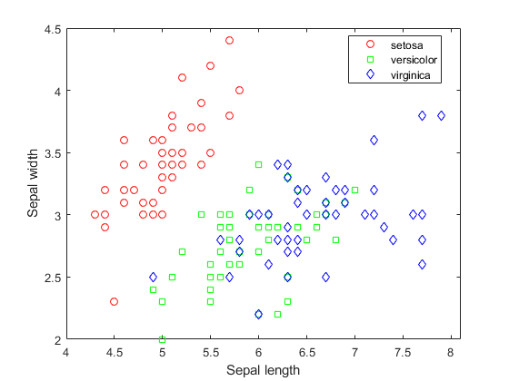
Iris Data

Slide 10
Error Rate
150 samples, 50 of each iris type
Let’s say that we predicted
120 correctly
30 incorrectly
Error Rate = 30/150 = 0.2 (20%)
Limited View

Slide 11
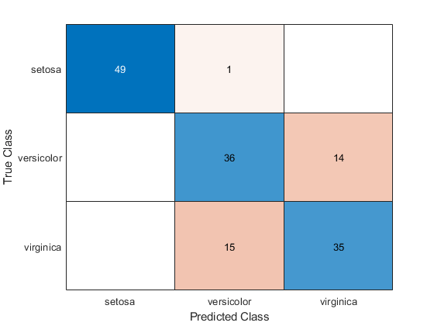
Error Rate and Confusion Matrix
Error Rate = 0.2 (20%)

Slide 12
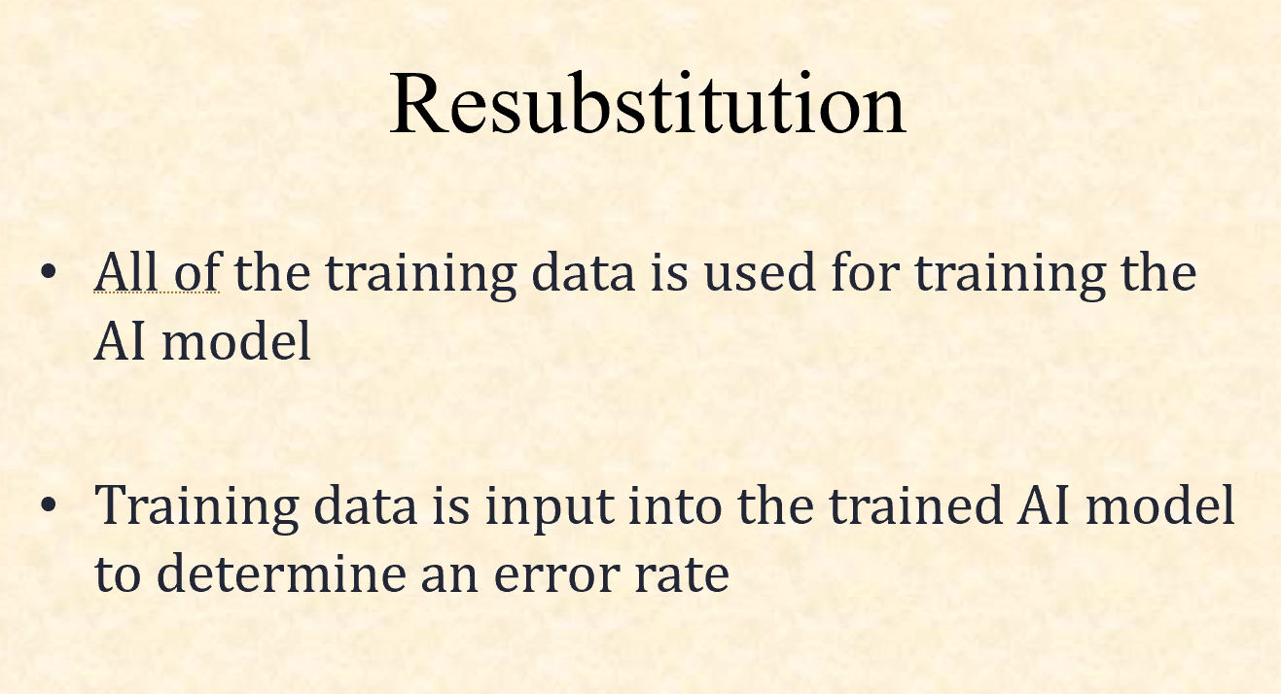
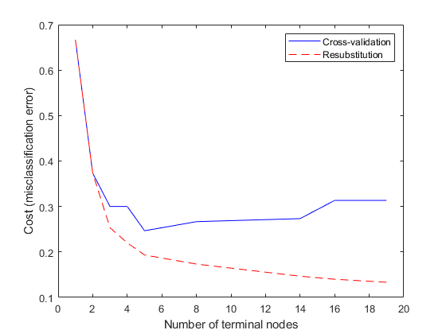
Iris Data – Decision Tree
Recall
Validation Techniques Matter
Avoid
Overfitting

Slide 13
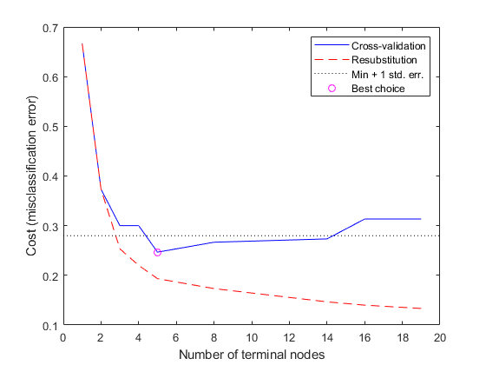
Iris Data – Decision Tree

Slide 14
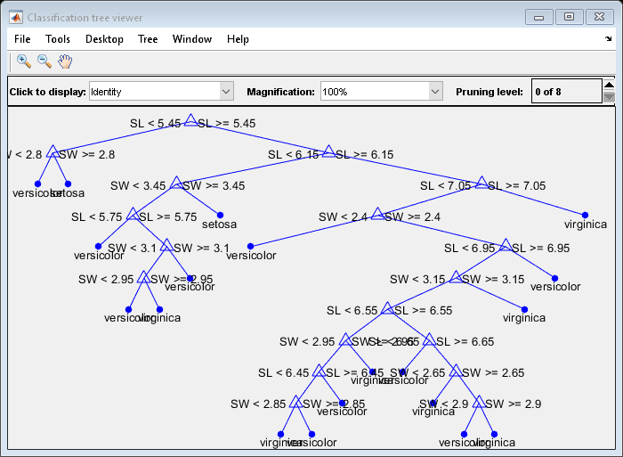
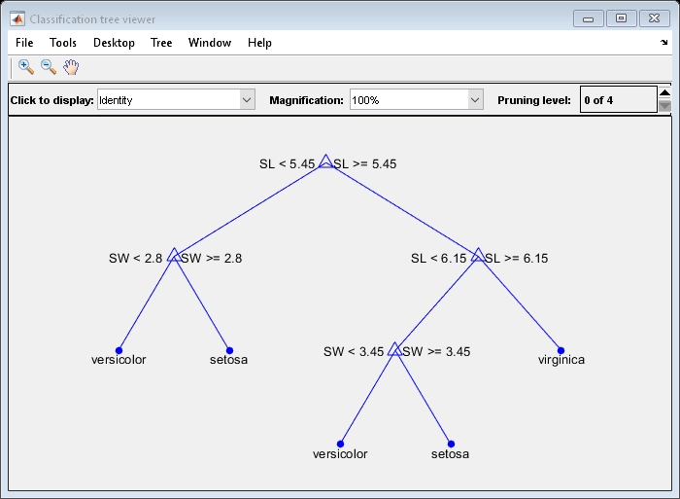
Iris Data – Decision Tree

Slide 15
Iris Data – Decision Tree
resubcost = resubLoss(t,'Subtrees','all’);
[cost,secost,ntermnodes,bestlevel] = cvloss(t,'Subtrees','all’);
plot(ntermnodes,cost,'b-', ntermnodes,resubcost,'r--’)
figure(gcf);

